Slide 1

Customer Reviews Project
-By Group 1
Ritesh Singh
Dawood M D.
Sakshi Raju Nimje
Uttam Kumar Pandey

Slide 2
Contents
Objective
Introduction
EDA
Sentimental Analysis
Model Building
Deployment

Slide 3
Objective
The goal of the Amazon Customer Reviews Sentiment Analysis project is to create a machine learning model that can analyze customer reviews and classify their sentiment as either positive or negative.
This analysis will help businesses understand customer opinions, improve products, enhance customer satisfaction, and monitor brand reputation.

Slide 4

Introduction
Sentiment Analysis is a natural language processing (NLP) technique used to determine the emotional tone behind words.
It is commonly used to analyze customer reviews, social media posts, and other textual data to understand the sentiment expressed (positive, negative, or neutral).
We selected Noise Newly Launched ColorFit Pro 5 Max 1.96" AMOLED Display Smart Watch
Special Feature | : Activity Tracker, Calorie Tracker, Oxymeter (SpO2), Notifications, Heart Rate Monitor
Connectivity Technology | : Bluetooth
Wireless Communication Standard | : Bluetooth

Slide 5
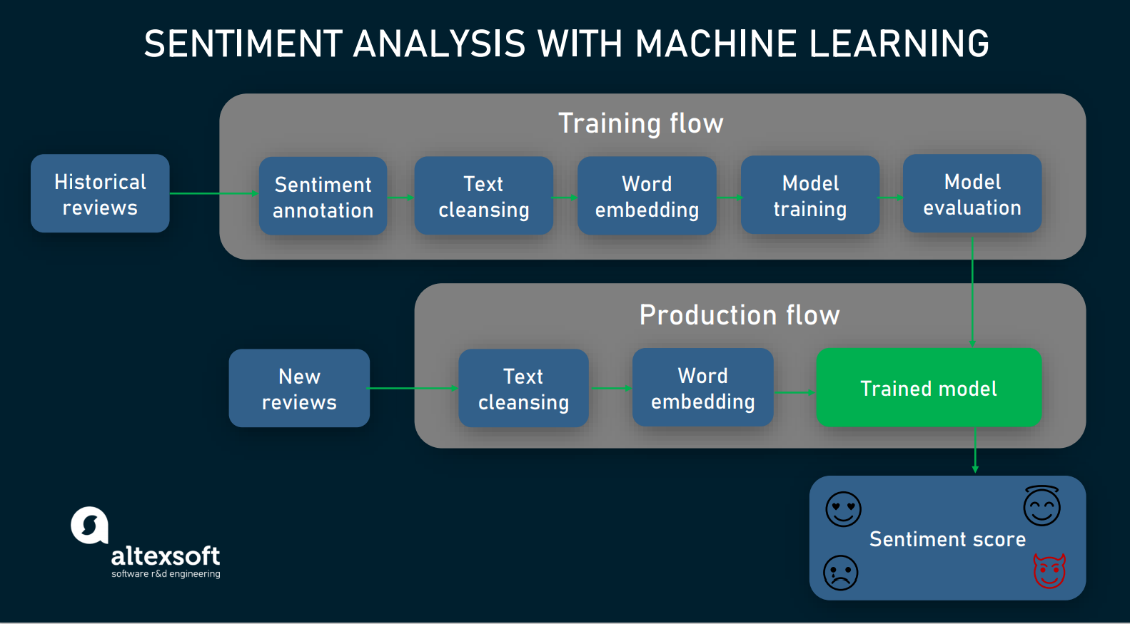

Slide 6
EDA
Exploratory Data Analysis (EDA) is a crucial step in understanding the dataset and uncovering patterns, anomalies, and relationships in the data.
For the Amazon Customer Reviews Sentiment Analysis project, EDA involves the following steps and visualizations:

Slide 7
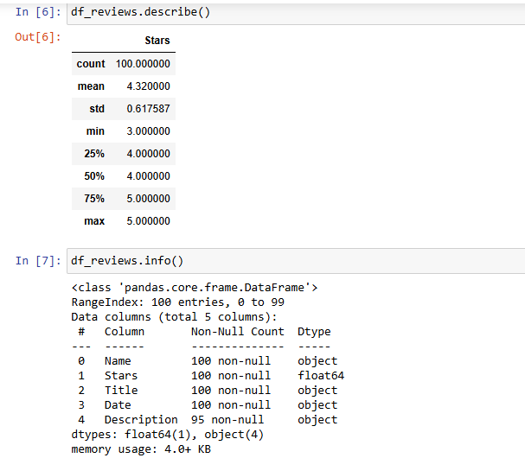
Understanding the Data

Slide 8
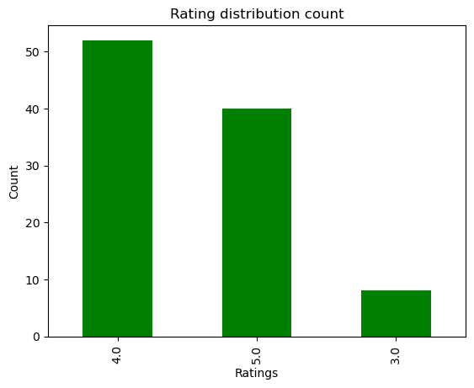
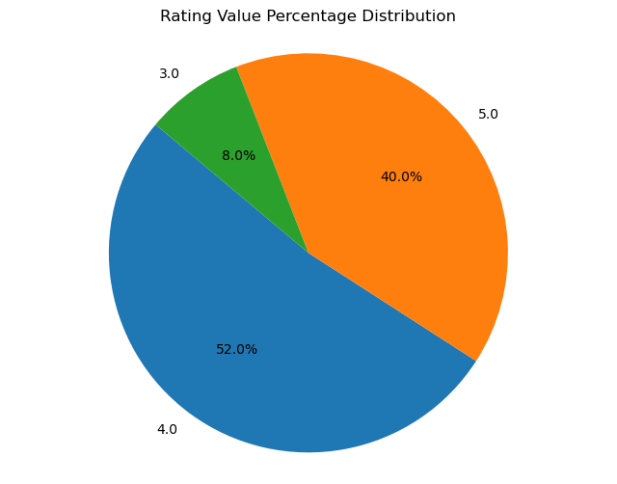
Rating Distribution

Slide 9
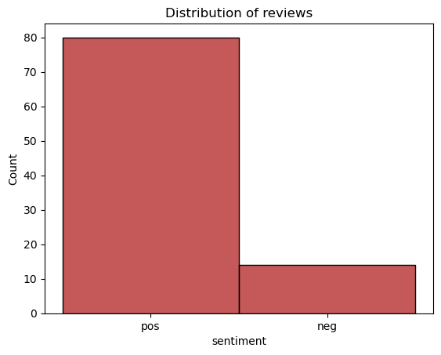
Sentiment Analysis
Sentiment Analysis is a widely used text classification tool that analyzes incoming messages to determine whether the underlying sentiment is positive or negative.
In this sentiment analysis project, we have performed the following steps:
Removed Emojis
Sentiment Extraction: we used nltk and textblob libraries
Text Cleaning
Stop Words Removal
Lemmatization
Feature Extraction: Used TF-IDF
Word Clouds: Generated positive and negative word clouds to visualize the most frequent words associated with each sentiment.

Slide 10
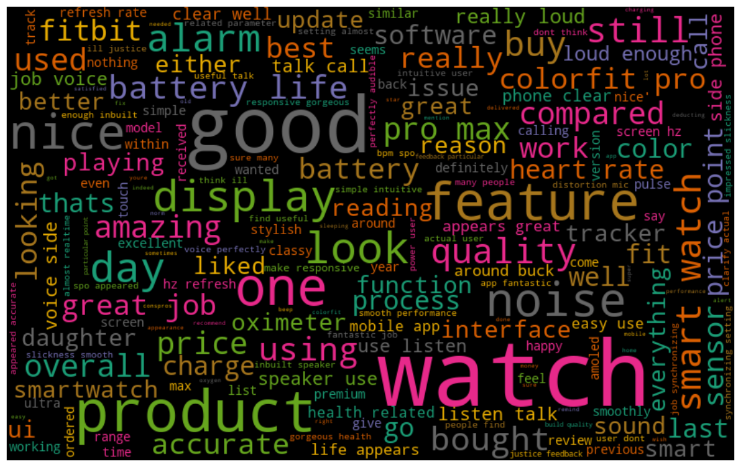
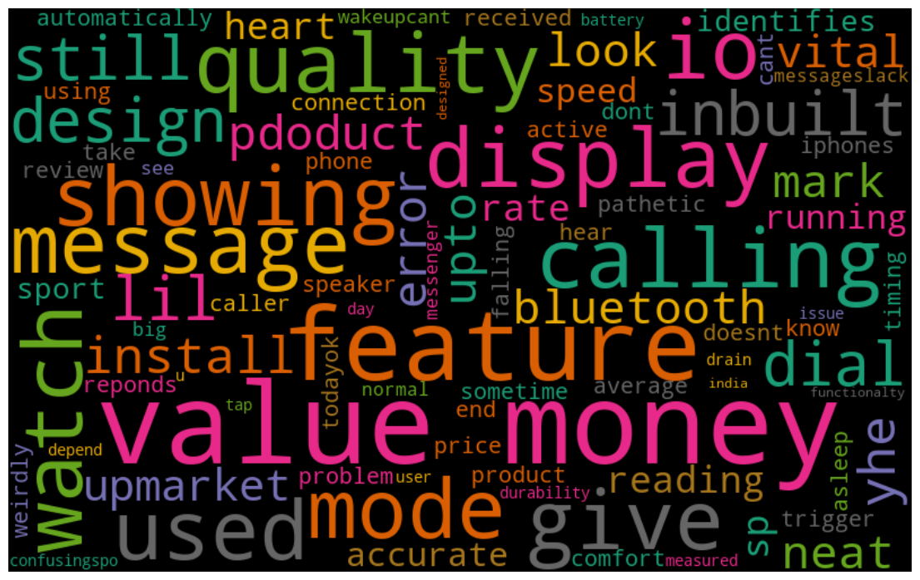
Positive Words
Negative Words

Slide 11
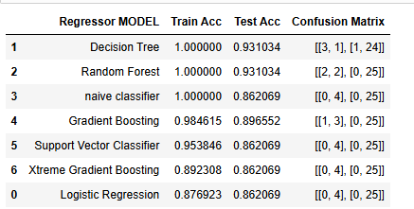
Model Building
Using various Machine Learning model we calculate the train, test Accuracy and confusion matrix.

Slide 12
We compared all the models and finalized that Logistic Regression is our chosen model, as it provides an accuracy of 86%.

Slide 13
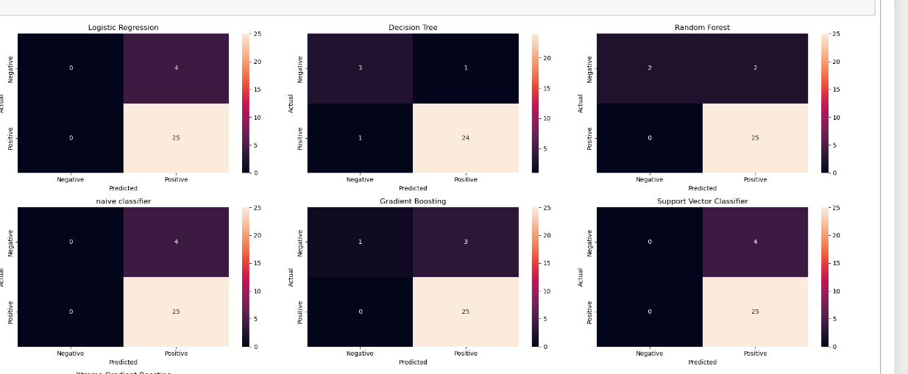
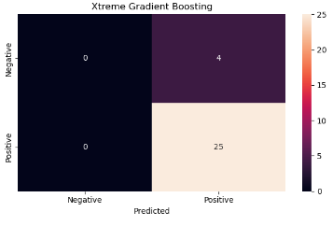
confusion matrix plot

Slide 14
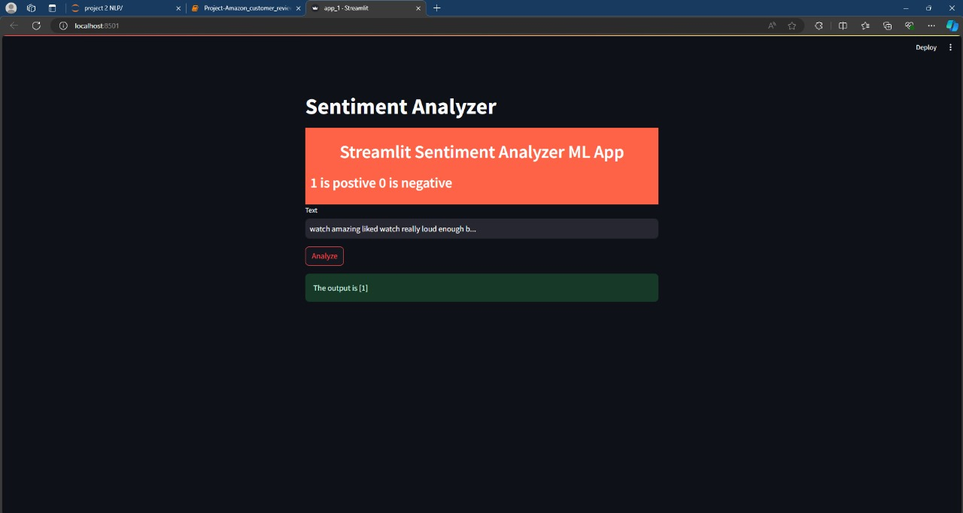
Deployment
Streamlit framework is used to deploy Logistic Regression Model.

Slide 15
THANK YOU

